Slide 1
Practical Machine learning
Google Developer Clubs

Slide 2
Contents
Introduction to Popular Machine Learning Libraries
Keras and TensorFlow– an intro
Building a basic model

Slide 3

TensorFlow
TensorFlow : - An Open-source Deep Learning library built by Google . Tensorflow can be coded both in High-Level tf.Keras (recommended), Estimators, and Low-Level API’s

Slide 4

Keras
Keras :- An Open-source Neural-Network library written in Python. It is capable of running on top of TensorFlow, Theano , Microsoft Cognitive Toolkit, Theano, or PlaidML..etc.

Slide 5

pytorch
PyTorch : - An open-source machine learning library for Python, based on Torch, used for applications such as NLP and owned by Facebook 's Artificial-intelligence research group.

Slide 6

Scikit-Learn
Scikit-Learn : Scikit-learn is a free software machine learning library for the Python programming language. It features various classification, regression and clustering algorithms including support vector machines,

Slide 7

Theano
Theano : - library that allows you to define, evaluate and optimize the mathematical expressions that entail multi-dimensional arrays efficiently. It is one of the most heavily used deep learning libraries.

Slide 8
Why keras ?
Keras offers the advantages of broad adoption, support for a wide range of production deployment options, integration with at least five back-end engines (TensorFlow, CNTK, Theano, MXNet, and PlaidML),
Strong support for multiple GPUs and distributed training. Plus, Keras is backed by Google, Microsoft, Amazon, Apple, Nvidia, Uber, and others.
Keras is capable of running on top of TensorFlow, Microsoft Cognitive Toolkit, Theano, or PlaidML.
Designed to enable fast experimentation with Deep Neural Networks, it focuses on being user-friendly, modular, and extensible.

Slide 9
How keras works?
Keras Doesn’t have it’s own Back-End Engine

Slide 10
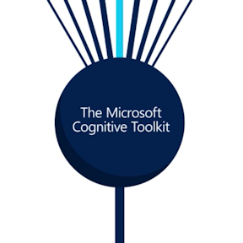


Slide 11
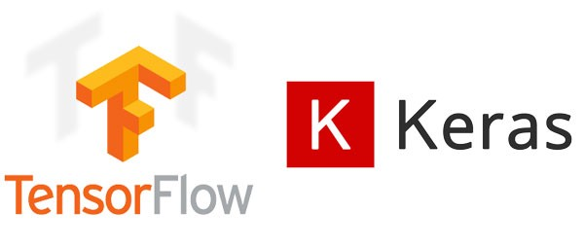
Keras and TensorFlow
Keras is part of TensorFlow in recently released TensorFlow API2
Keras was created to be user friendly, modular, easy to extend, and to work with Python. The API was “designed for human beings, not machines,” and “follows best practices for reducing cognitive load.”
Neural layers, cost functions, optimizers, initialization schemes, activation functions, and regularization schemes are all standalone modules that you can combine to create new models. New modules are simple to add, as new classes and functions. Models are defined in Python code, not separate model configuration files.

Slide 12
Building a basic Model
Overview Of Dataset :
Today we will be using Fashion MNIST dataset which contains 70,000 grayscale images in 10 categories. The images show individual articles of clothing at low resolution (28 by 28 pixels), as seen here
Fashion MNIST is intended as the "Hello, World" of machine learning programs for computer vision
We will use 60,000 images to train the network and 10,000 images to evaluate how accurately the network learned to classify images. You can access the Fashion MNIST directly from TensorFlow, just import and load the data
Fashion MNIST dataset can be found under “keras.datasets.fashion_mnist”

Slide 13
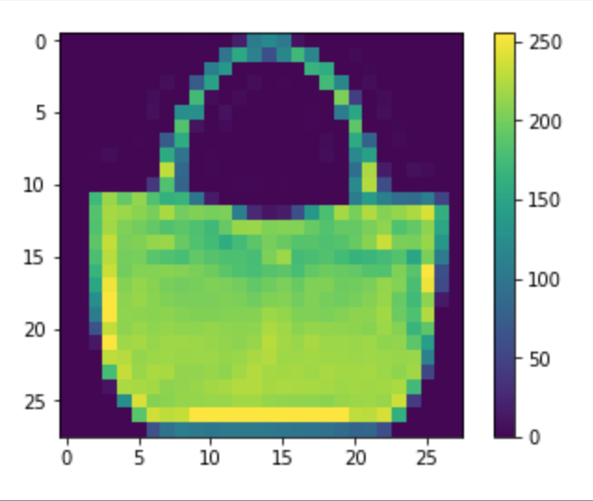
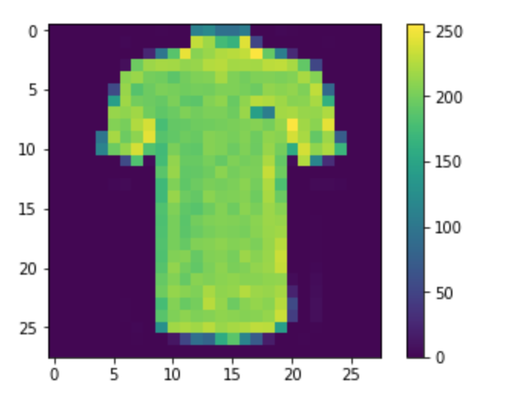
Overview of The dataset

Slide 14
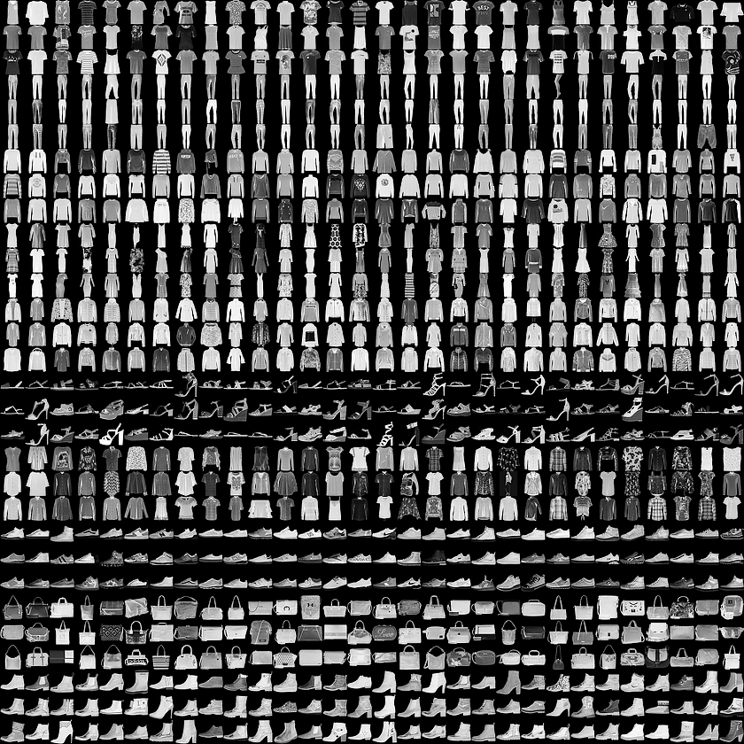

Slide 15
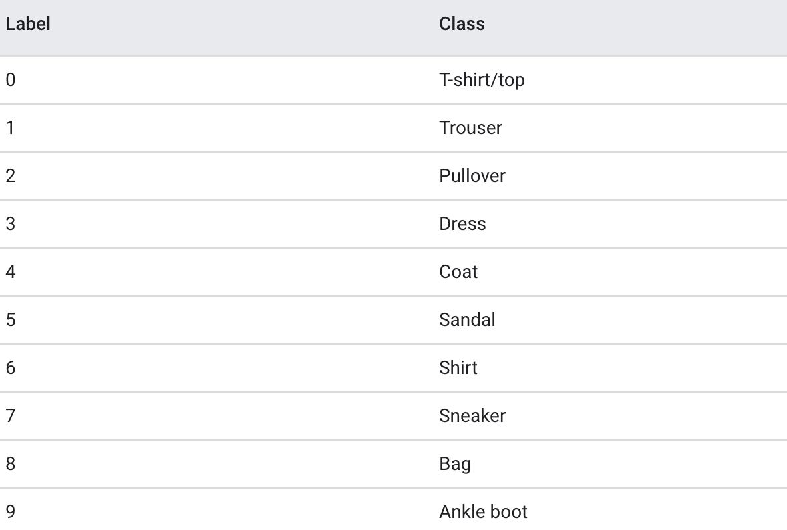
10 Classes of Fashion MNIST Dataset
One-hot encoded

Slide 16
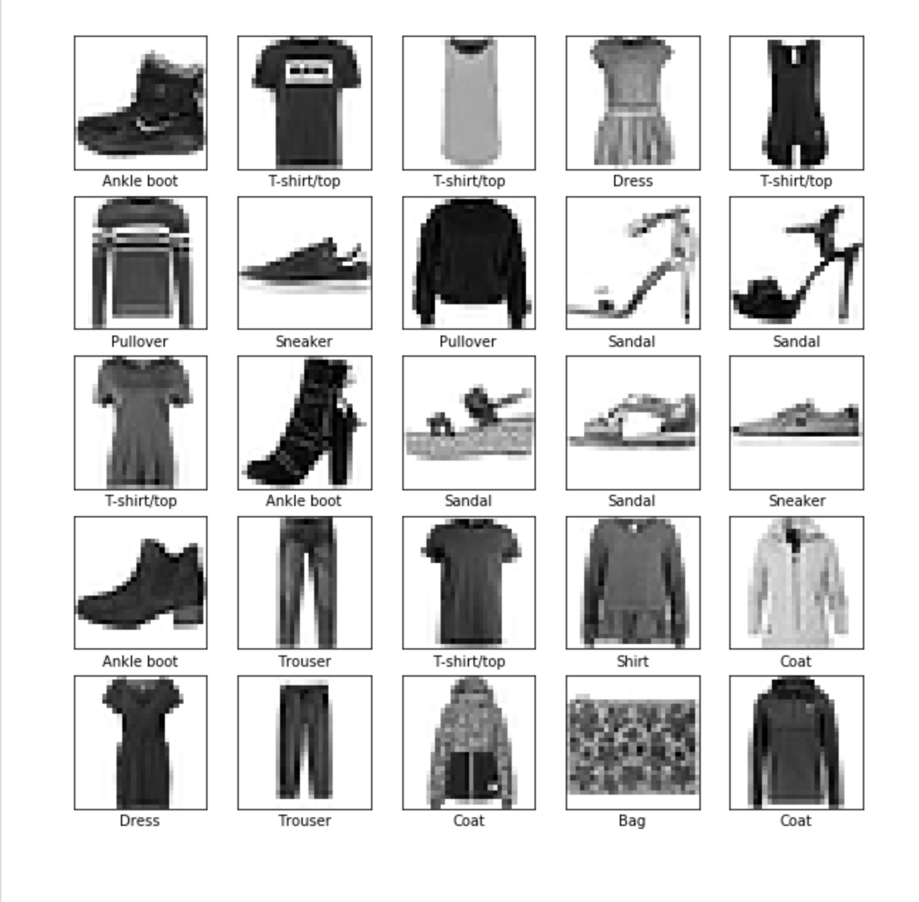
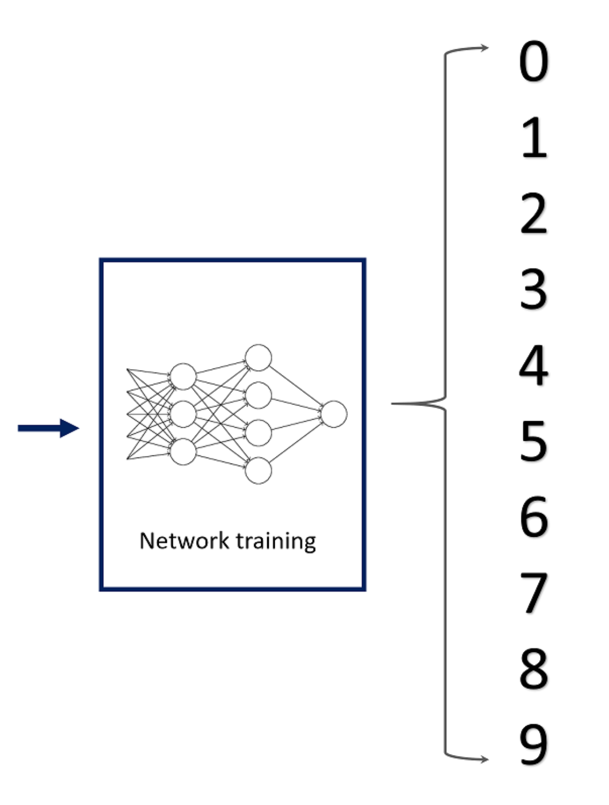
Training of the neural network
Here (0-9) Being the class indices

Slide 17
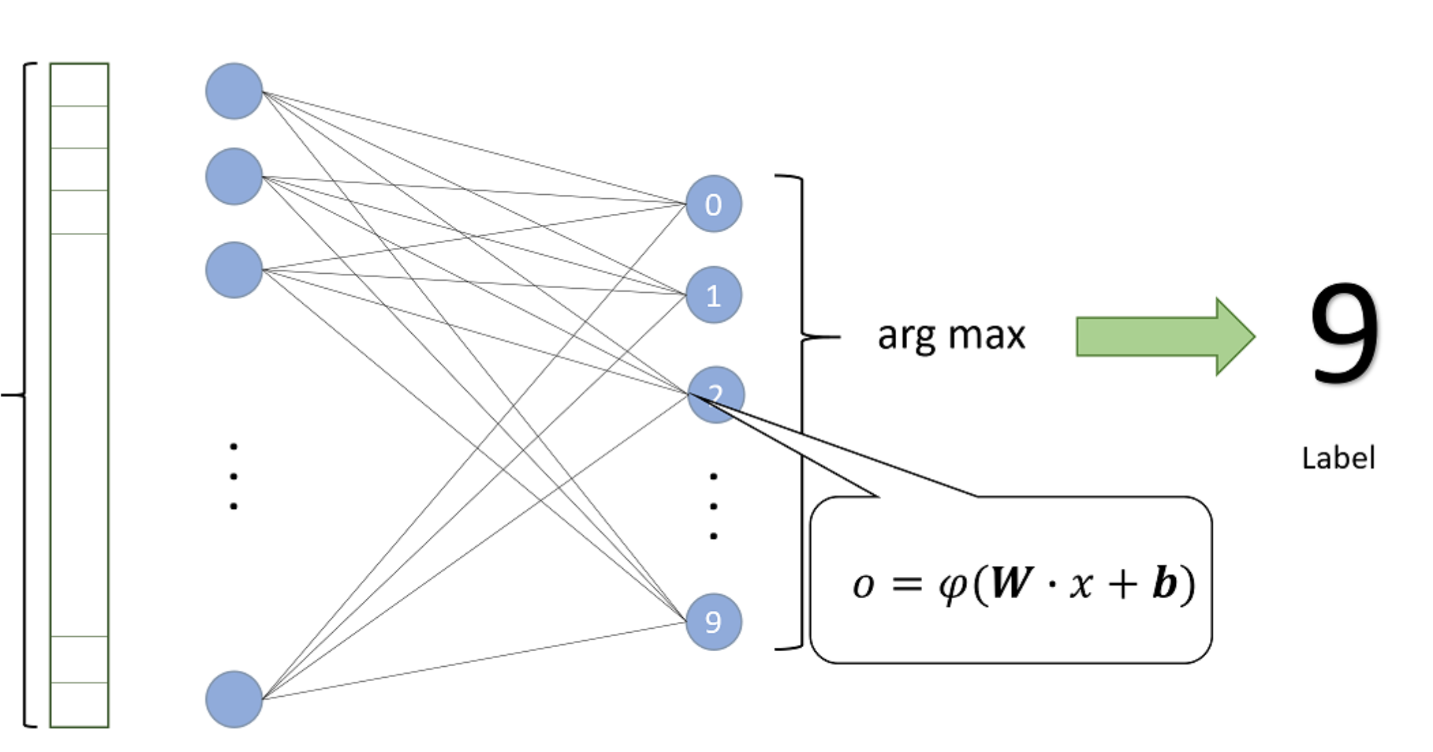
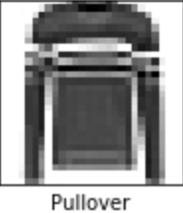
Input Data
Input Layer
Output Layer

Slide 18

Tools used : -
* To build and train the model we will be using Google Colab.
We will be using Google Colab in `GPU` runtime mode for better performance.
All the code and explanation can be found on TensorFlow DOCS .
Corresponding link : https://www.tensorflow.org/tutorials/keras/basic_classification

Slide 19
